Slide 1



Introduction to AtliQ Hospitality
AtliQ Hospitality is dedicated to providing exceptional experiences in the hospitality industry, offering luxurious accommodations, exquisite dining, and world-class amenities.
by Shalini Pal

Slide 2

Analysis Overview
Market Trends
Performance Analysis
Customer Feedback
Exploring the current trends shaping the hospitality industry.
Evaluating key metrics to assess the success of AtliQ Hotels.
Analyzing customer input to gauge satisfaction and identify pain points.
Understanding customer preferences and behavior.
Identifying areas of improvement and growth opportunities.
Seeking areas for enhancing the overall guest experience.

Slide 3




Key Performance Indicators in the Project
Revenue
Occupancy
Guest Satisfaction
Market Share
Evaluating financial performance and growth.
Tracking room utilization and demand trends.
Measuring overall guest experience and feedback.
Analyzing competitiveness and industry positioning.

Slide 4
Market Trends and Insights
1
Digital Transformation
2
Sustainability Practices
Impact of technology on guest interactions and service delivery.
How eco-friendly initiatives are influencing consumer choices.
3
Personalization and Customization
4
Community Engagement
Building strong local connections for a more authentic guest experience.
Meeting the increasing demand for personalized guest experiences.

Slide 5
Performance of AtliQ Hotels
Occupancy Rate
58%
Average Daily Rate
18.10k
Revenue per Available Room
1709M
Average Ratings
3.6

Slide 6
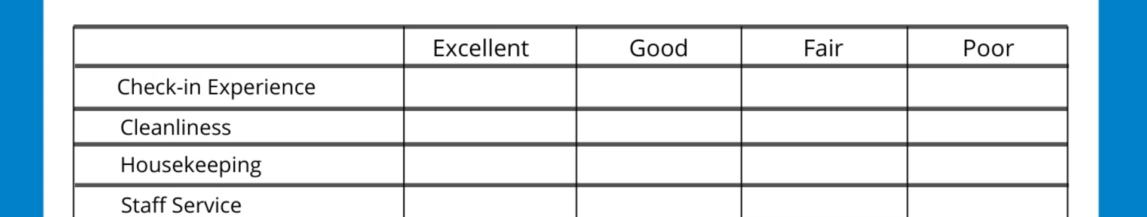



Customer Satisfaction and Feedback
Guest Surveys
Online Reviews
Staff Interactions
Obtaining direct insights on guest satisfaction and areas for improvement.
Analyzing feedback and ratings on various online platforms.
Examining feedback related to staff behavior and responsiveness.

Slide 7
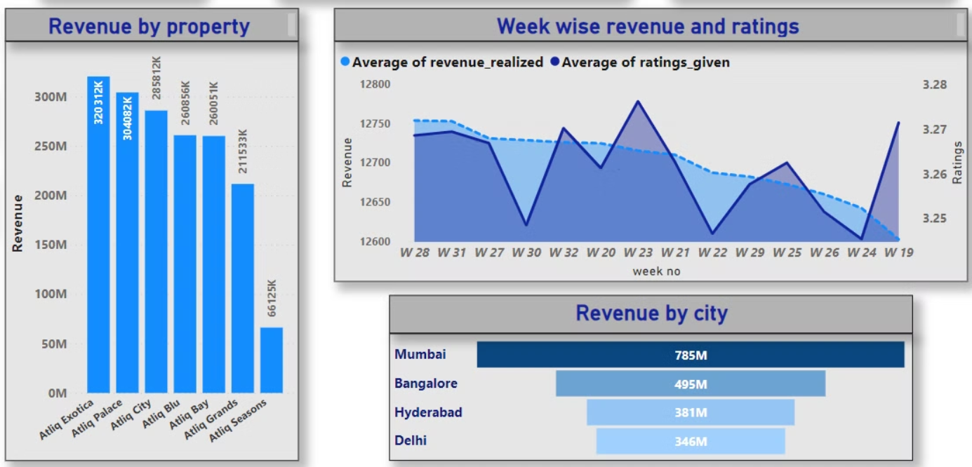
AtliQ data analysis report

Slide 8

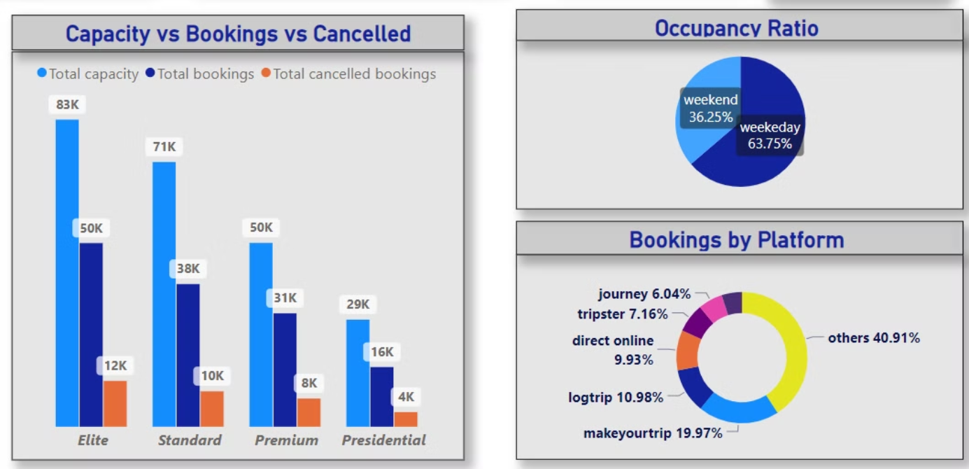

Slide 9

Recommendations for Improvement
1
Enhanced Training
Providing staff with targeted training to enhance service quality.
2
Technological Integration
Implementing digital solutions to streamline guest interactions.
3
Guest Experience Initiatives
Introducing new programs to elevate the overall guest experience.

Slide 10

Conclusion and Next Steps
Implementation Plan
Monitoring and Feedback
Developing a comprehensive strategy for executing recommended enhancements.
Establishing a system for ongoing performance evaluation and guest feedback monitoring.
Long-term Vision
Aligning future initiatives with the overarching goals of AtliQ Hospitality.

